Slide 1
MCS 7224: COMPUTER VISION
TRAFFIC MONITORING TOOL USING MACHINE LEARNING
Presented by:
Ahimbisibwe Acleophas
2023/HD05/46462U
2300704646
ahimbisibwe.acleophas@students.mak.ac.ug
YouTube link: https://youtu.be/ZxzKpukDW2E

Slide 2
Contents of Presentation
Introduction
Related Work
Methodology
Dataset Description
Data Preprocessing
Model deployment and Implementation
Model Evaluation
Analysis of Results
Conclusion

Slide 3
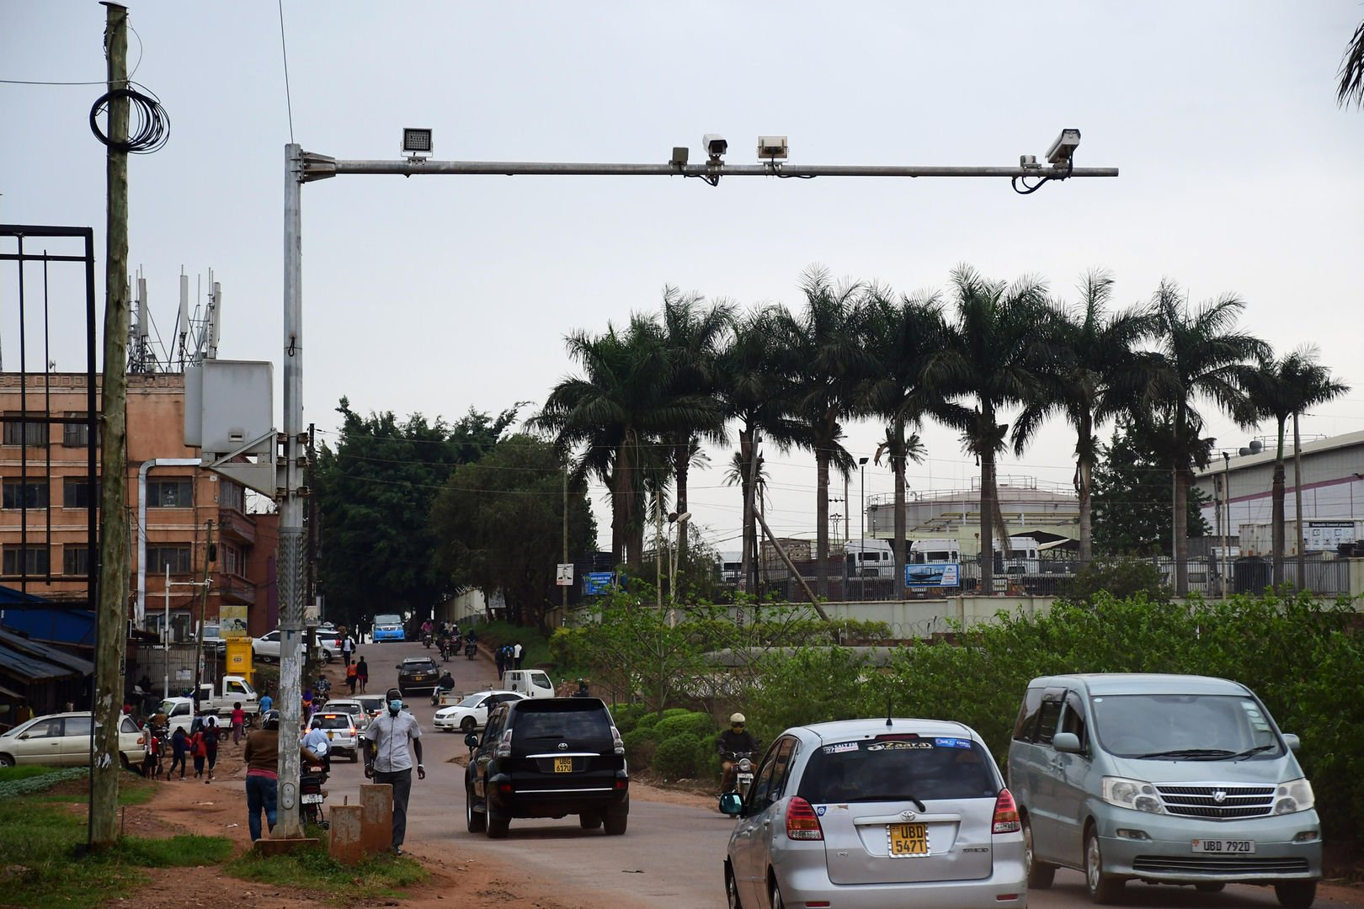
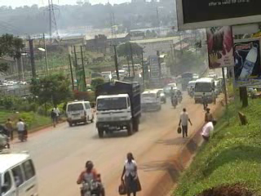
Introduction
Traffic Flow
Road cameras

Slide 4
Related Work
Support Vector Machines (SVMs)
Vapnik, V.N. and Vapnik, V., 1998. Statistical learning theory.
Random Forests
Breiman, L., 2001. Random forests. Machine learning, 45, pp.5-32.
k-Nearest Neighbors (k-NN)
Cover, T. and Hart, P., 1967. Nearest neighbor pattern classification. IEEE transactions on information theory, 13(1), pp.21-27
Logistic Regression
Hosmer, D.W., 2000. Applied logistic regression, 2.
Decision Tree Classifier
Quinlan, J.R., 1986. Induction of decision trees. Machine learning, 1, pp.81-106

Slide 5
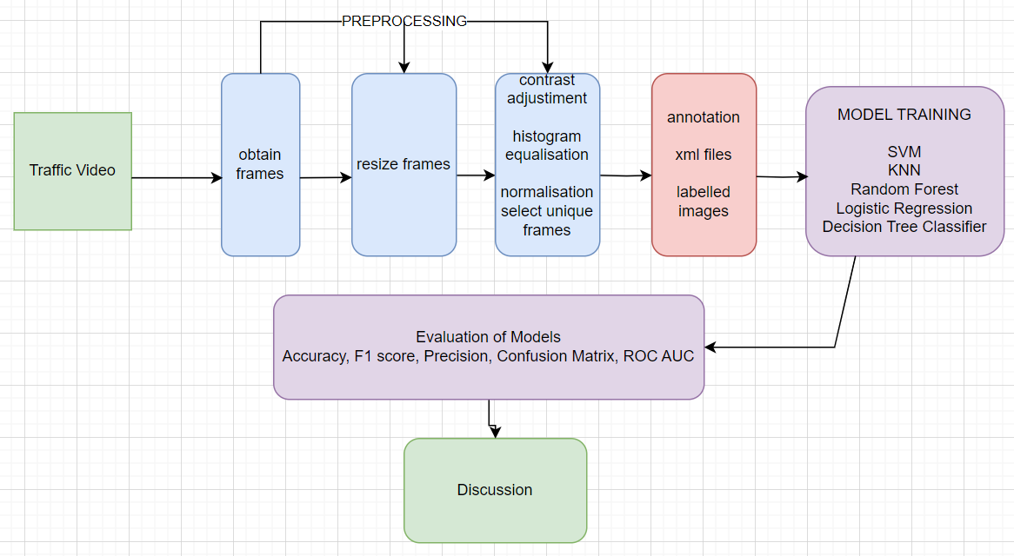
Methodology

Slide 6
Dataset Description
The dataset for nakawa traffic was downloaded which consists of a collection of video recordings that capture diverse aspects of traffic dynamics in Nakawa, recorded from strategically placed traffic cameras, the dataset encompasses a wide range of traffic scenarios, including intersections, pedestrians, and urban streets, across different times of day.

Slide 7
Data Preprocessing
Extraction of frames video
Annotation
Frame resizing to a consistent resolution
Frame normalization to standardize pixel values
Augmentation techniques like rotation, flipping, brightness adjustment
Formulate datasets to be used in training models

Slide 8
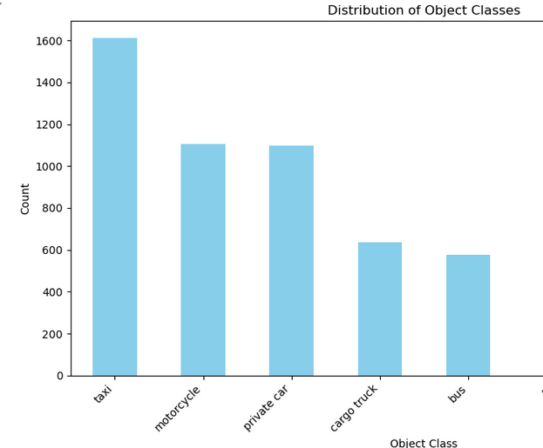
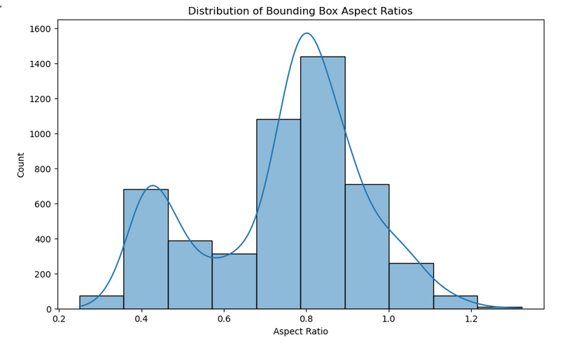
EDA

Slide 9
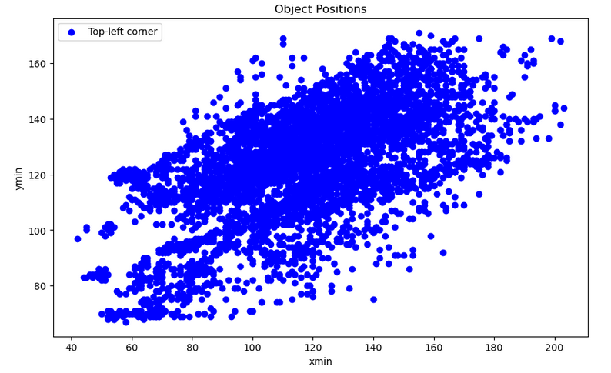
EDA continued

Slide 10
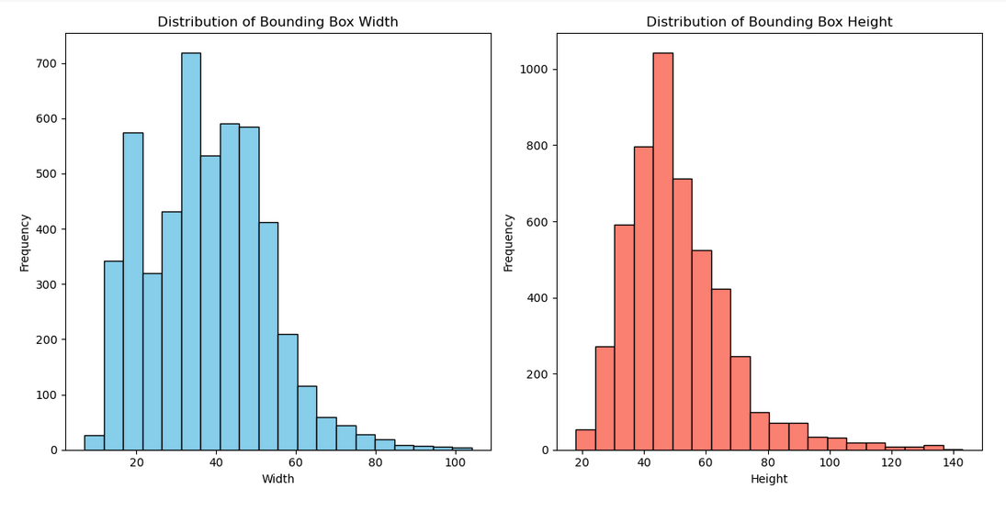
EDA continued

Slide 11
Model Deployment and Implementation
Four Machine Learning models were implemented ie
Support Vector Machines (SVMs)
Random Forests,
k-Nearest Neighbors (k-NN)
Logistic Regression
Decision Tree Classifier
Ensemble Model

Slide 12
Model Evaluation
Train-Test Split(70%: 30%)
Performance metrics
Accuracy
Precision
Recall
F1-score
Area under the curve (AUC)

Slide 13
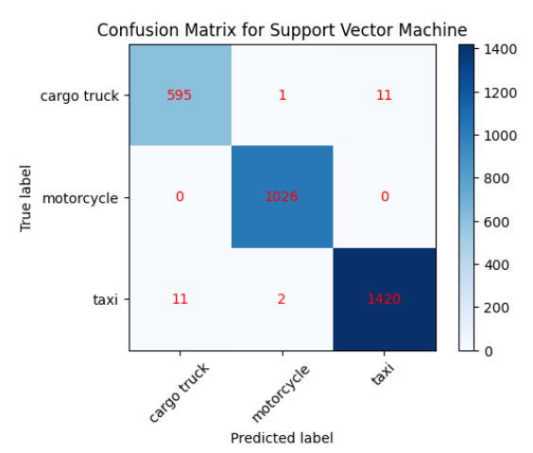
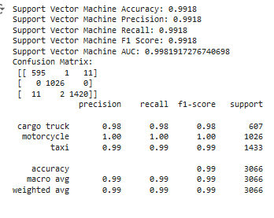
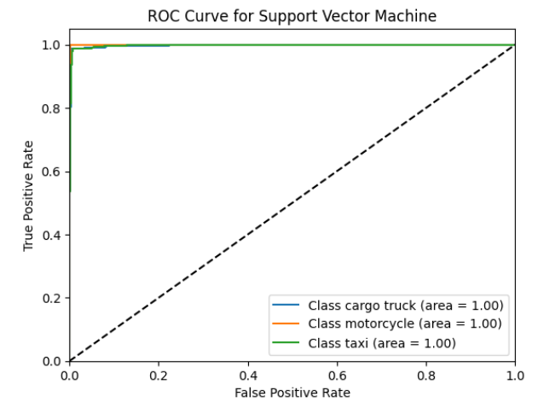
SVMs
A linear kernel for the SVM was implemented,
leveraging its simplicity and efficiency for our
traffic classification task.

Slide 14
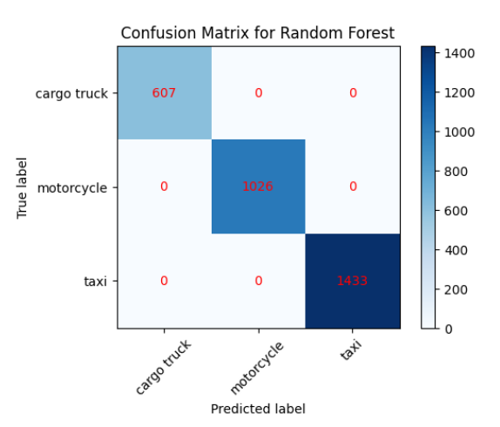
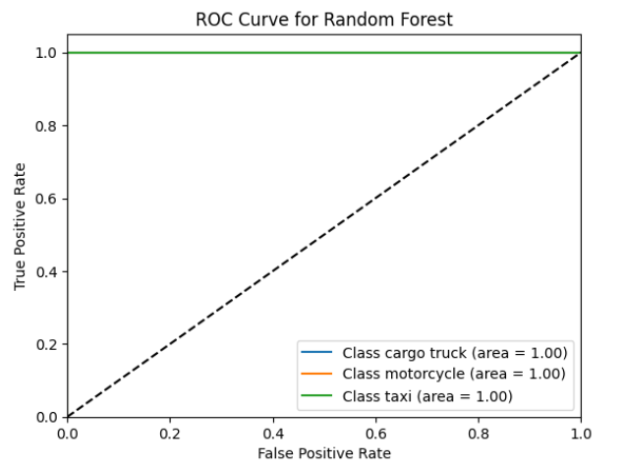
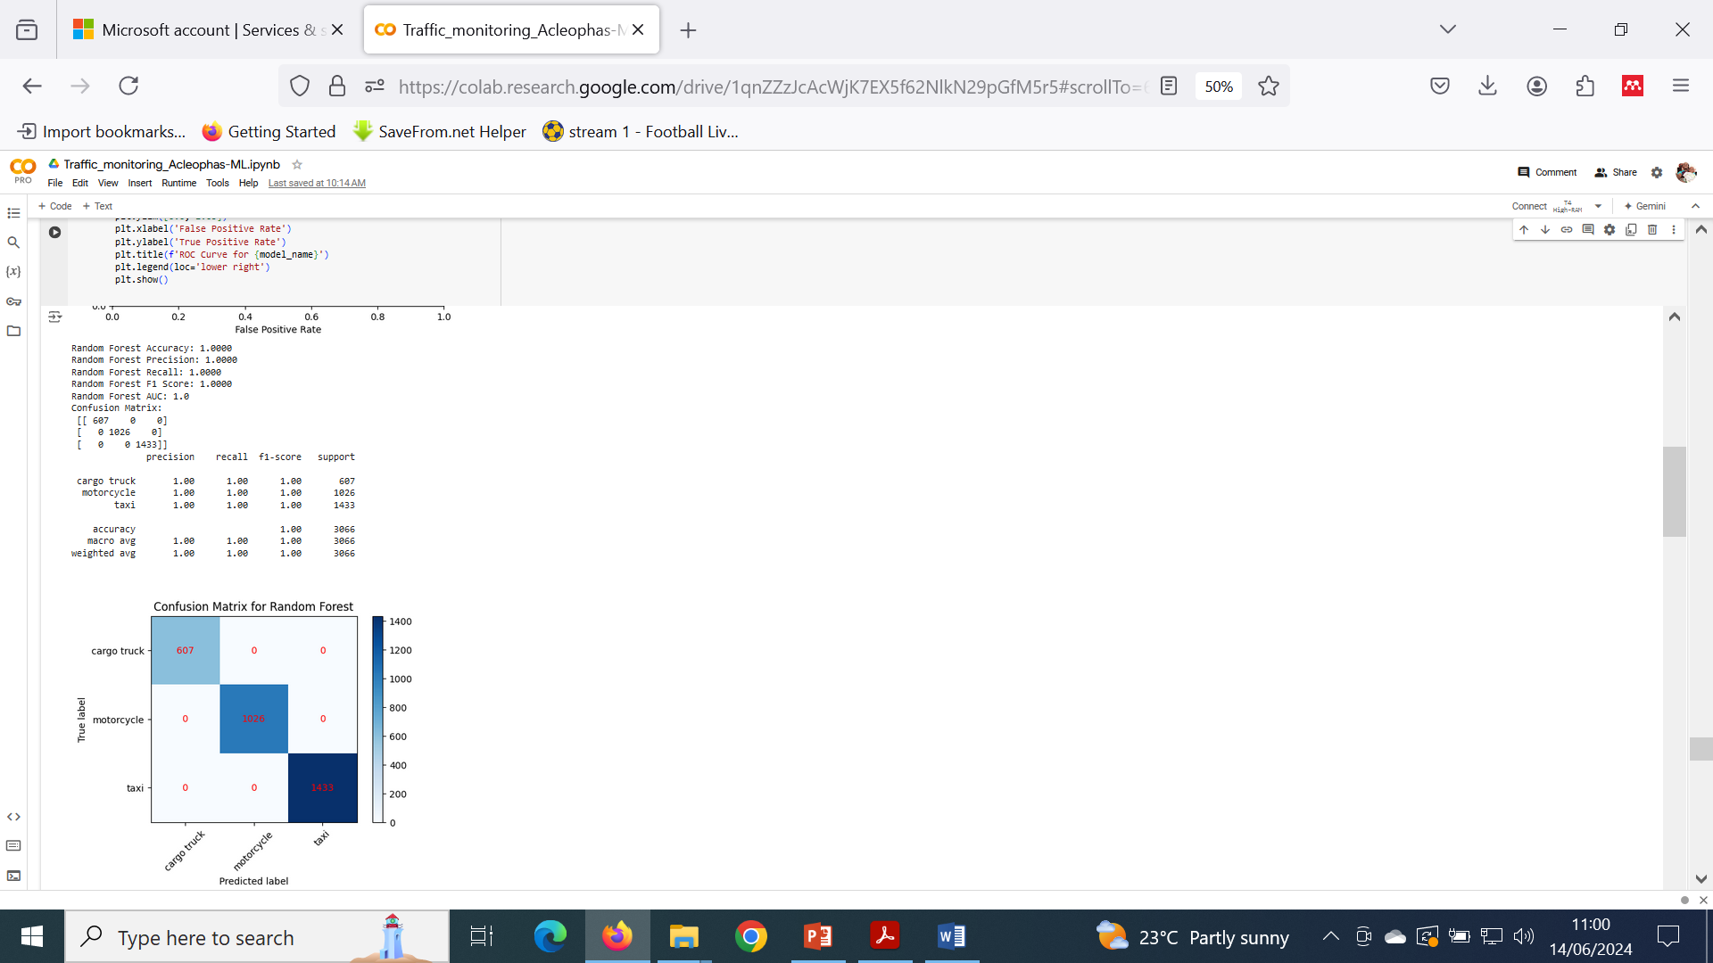
Random Forests
The Random Forest model was configured with
100 decision trees, providing a balance between
computational efficiency and performance.

Slide 15
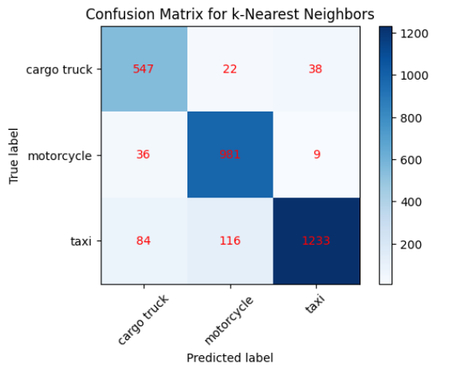
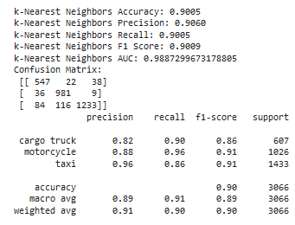
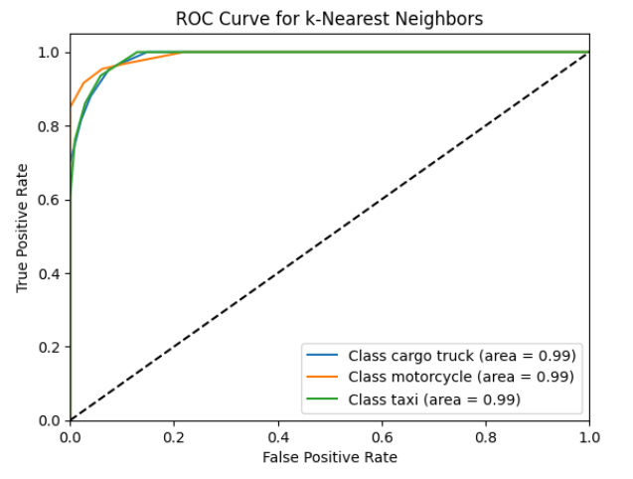
k-Nearest Neighbors (k-NN)
KNN classifier was configured with k=5, ensuring a balance between bias and variance in our traffic data classification.

Slide 16

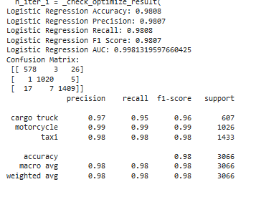
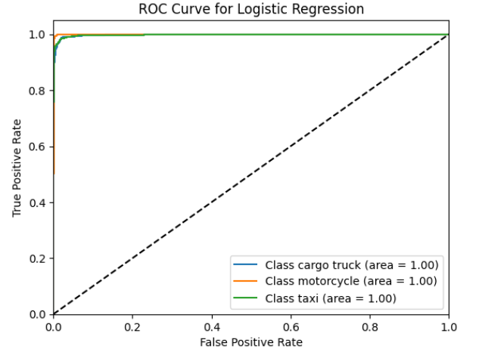
Logistic Regression
A multi-class logistic regression model was implemented using the one-vs-rest scheme to handle multiple traffic classes.

Slide 17
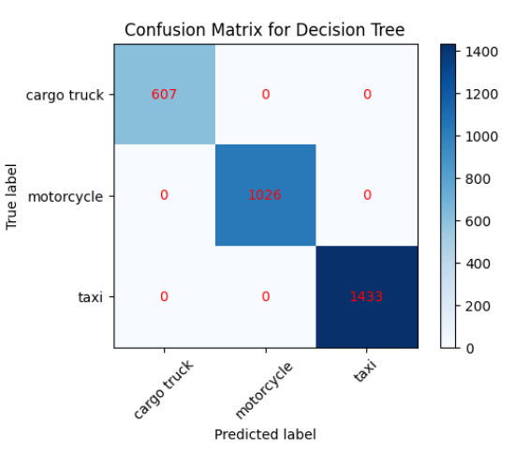
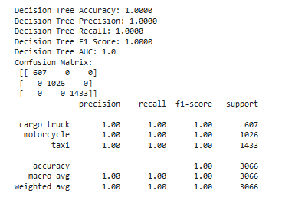
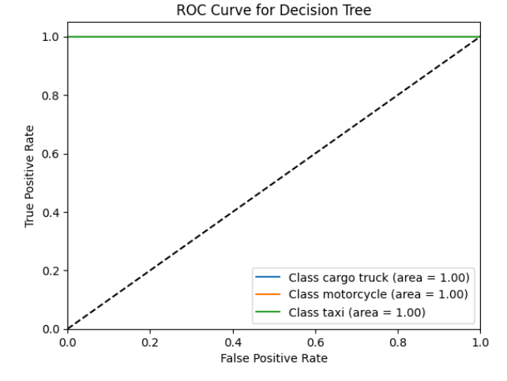
Decision Tree Classifier
The Decision Tree model was configured with default parameters to classify traffic images based on extracted color histogram features.

Slide 18

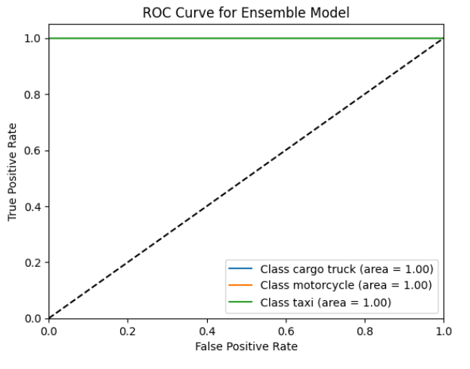
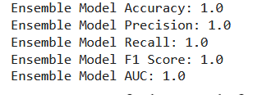
Ensemble Model
The Ensemble Model, which combines the predictions of multiple classifiers (SVM, KNN, RF and LR).

Slide 19
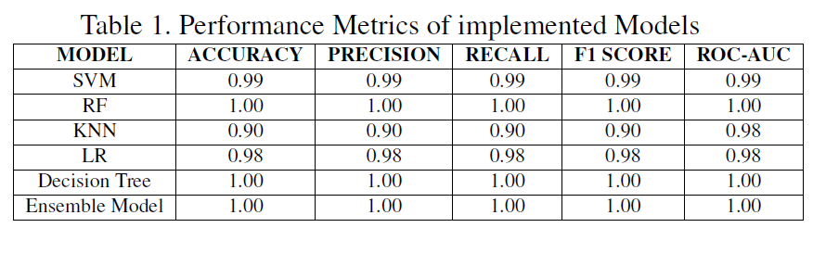

Slide 20
Conclusion
Machine learning models give an ideal technique for object detection
This study demonstrates that machine learning models, particularly Random Forest, Decision Tree, and an Ensemble Model, excel in traffic monitoring and classification, achieving perfect accuracy. SVM and Logistic Regression also perform robustly, while k-NN, though slightly less accurate, remains effective.
Github link
https://github.com/ahimbisibwe-acleophas/traffic-monitoring-tool-computer-vision-exam-2024

